Slide 1
Immune Profiling
Progress, Plans, and Problems

Slide 2
Progress Update as of early August 9, 2023
Jupyter Notebook Started
Learning Python
Access to, and use of, Database (IgBlast) resources
Graphing results of data processing
Figuring out how to use the data and exploring antibody biology
Continued writing the report and created a GitHub repository
How to go from an epitope (IEDB) to getting and immune profiling dataset (iReceptor)
Team
@Ashly Corona Rodriguez
@Keith Loritz
@Oscar Camargo
@Rashmi Naidu
@Miguel Angel Rizzo Ignacio
@Todd Smith
Mexico, Spain, USA

Slide 3
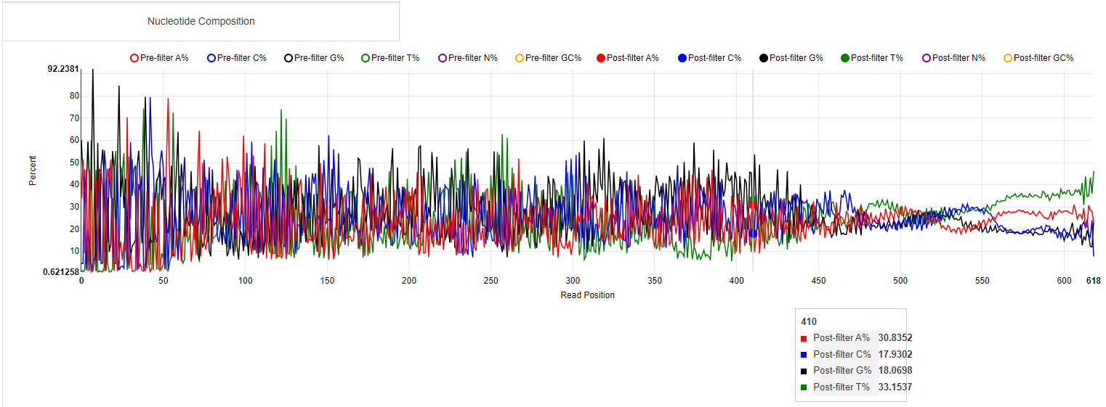
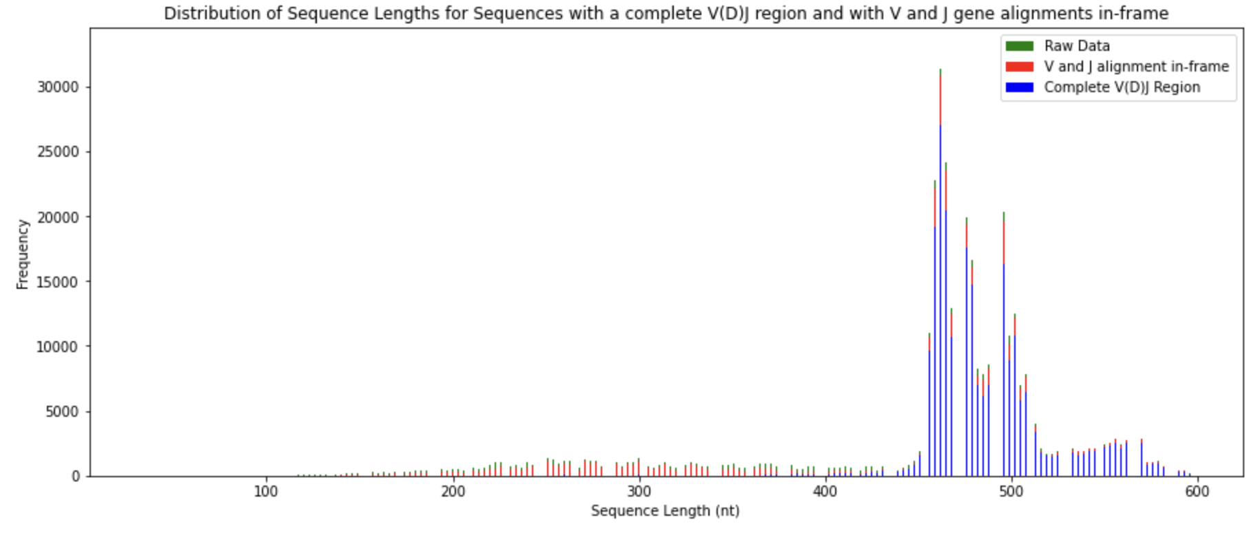
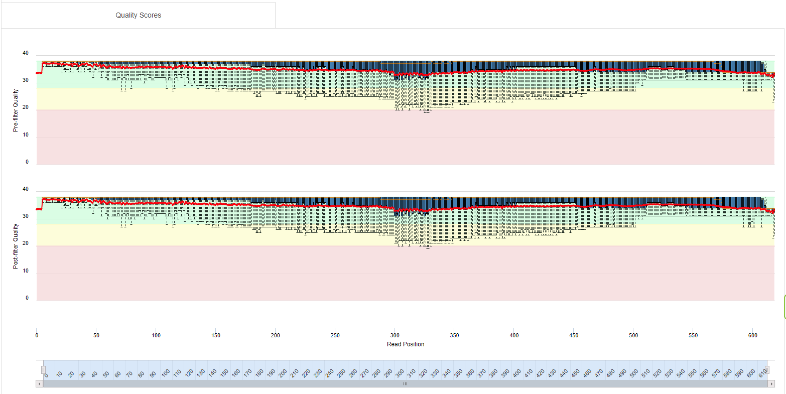
Exploring the dataset using the IgBlast documentation

Slide 4
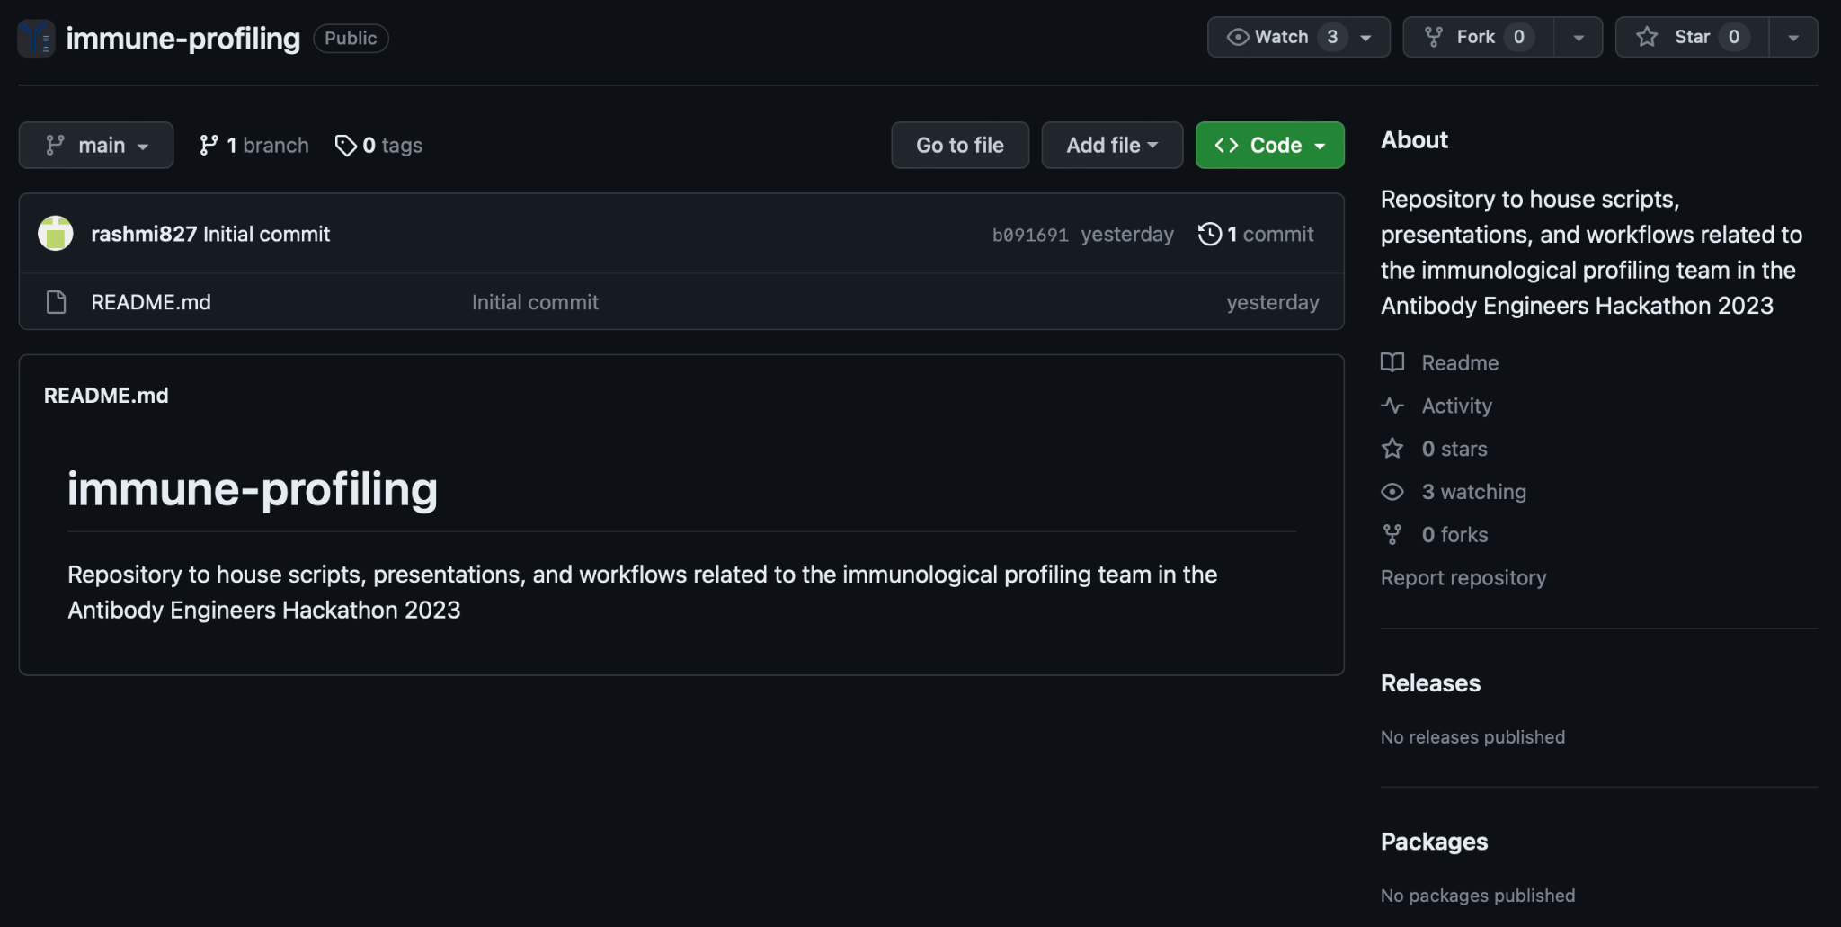
Creating and Structuring the GitHub Repository

Slide 5
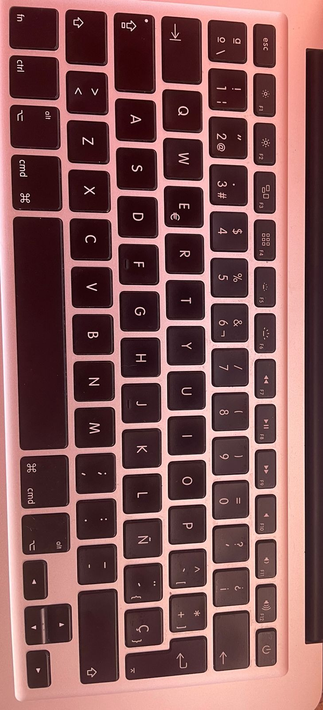
Problems
Differences between our keyboards (‘) and (á)
Rabbit Holes
Learning the different functions in the libraries we are using (Pandas, Matplotlib, etc.) and how to use our dataset from IgBlast
What happens when ChatGPT does not understand you?
JetStream outage

Slide 6
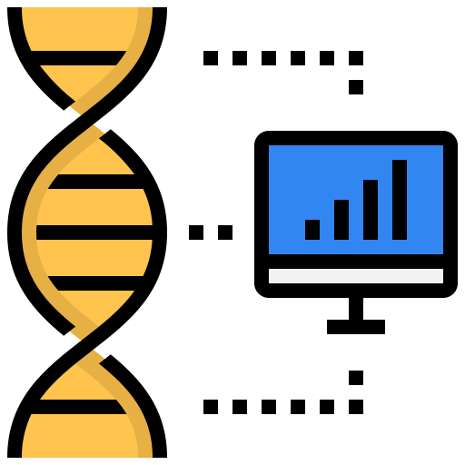
Plans
Continue writing the report
Discuss our findings
Keep exploring the data
Keep learning about Immune Profiling and bioinformatics

